Slide 1


Telemedicine: A Revolution in Healthcare

Slide 2
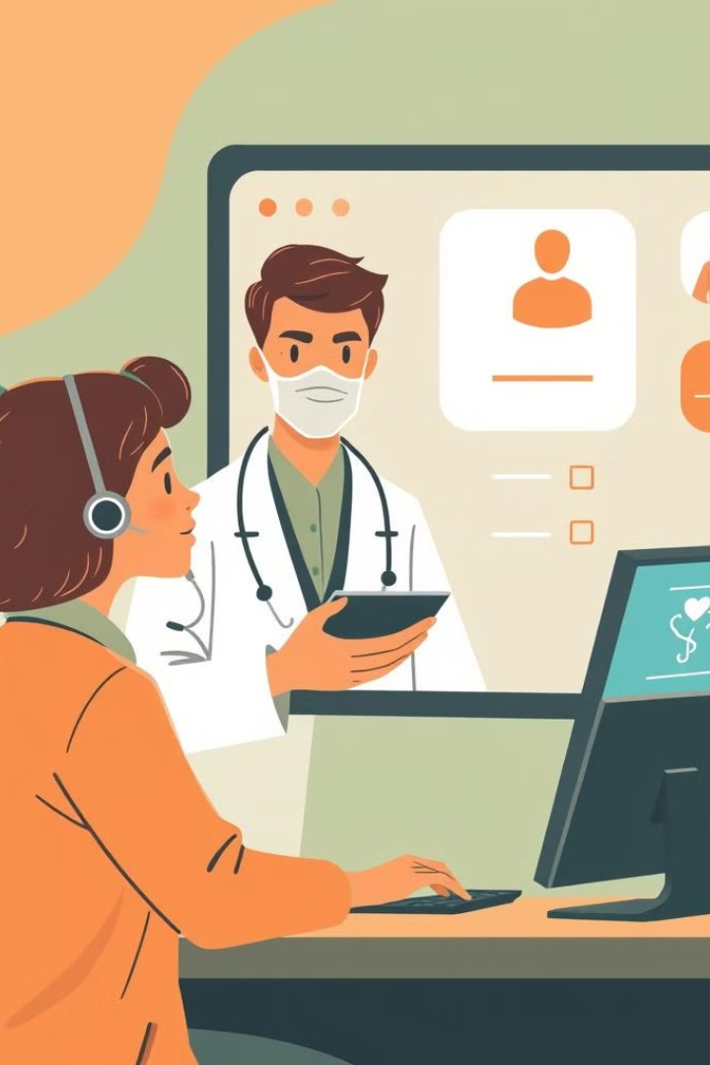


Telemedicine
Telemedicine, the remote delivery of healthcare services, has revolutionized the way we access and provide medical care.
This case study delves into the various aspects of telemedicine, its benefits, challenges, and its potential to reshape the healthcare landscape.

Slide 3

Case Study: The Impact of Telemedicine on Rural Healthcare
The Challenge
Telemedicine's Role
Many patients, especially those in rural or underserved areas, face challenges accessing timely and quality healthcare. This often leads to delayed diagnoses, poor health outcomes, and increased healthcare costs.
Telemedicine offers a solution providing remote access to specialists and facilitating regular check-ups for chronic conditions. This empowers rural communities to manage their health effectively and improve overall well-being.

Slide 4
Applying Design Thinking to Telemedicine
1
Empathize: Understand the User
2
Define
Understand the User: Conduct interviews, surveys, and observations with patients, healthcare providers, and others to understand their needs.
Define the Problem Statement:
Difficulty in scheduling appointments.
Long wait times
Limited access to specialists
Concerns about privacy and security
Lack of personalized care

Slide 5
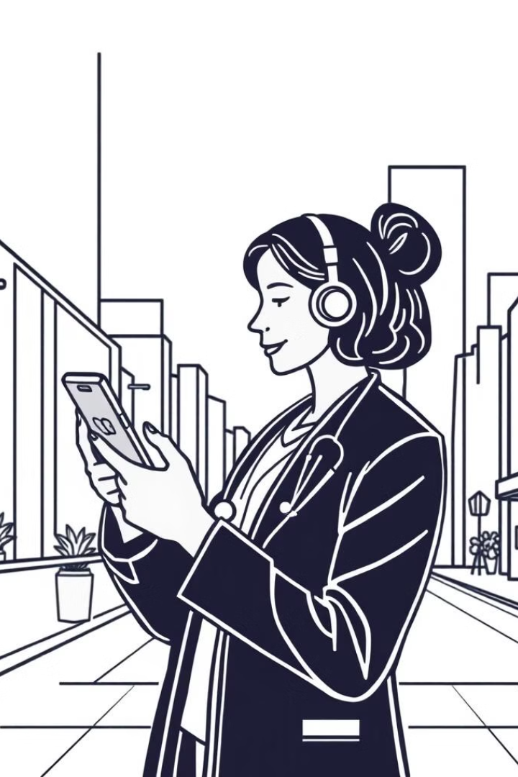
3.Ideate: Generate creative solutions
Generate Ideas: Consider ideas such as:
AI-powered Virtual consultations with specialists located in urban areas .
Real-time remote monitoring devices for chronic conditions
Virtual waiting rooms to reduce wait times

Slide 6


Prototype and Testing
Prototype Creation
The ideation phase leads to the development of prototypes, which are functional representations of the telemedicine platform. Given below are the results of a survey conducted in a hospital from February to December 2020.
Results: Response rates of patients and medical staff were 13.2% and 17.2%, respectively. More than 85% of medical staff replied that telemedicine was needed in COVID-19, whereas more than 80% of them worried about incomplete assessment and communication of medical condition. Overall satisfaction with telemedicine by medical staff was 49.7%. The strength of telephone-based telemedicine was patients' convenience (53.4%). However, incomplete assessment of patients' condition (55.0%) was its weakness.
Conclusion: Satisfaction with telephone-based telemedicine by patients was significantly greater than that by medical staff. Negative views for safety and inconvenience resulted in a greater proportion of dissatisfaction among medical staff.

Slide 7
TESTING
Key Areas to Test:
Platform Functionality:
Video and audio quality
Screen sharing capabilities
Document sharing
User Interface:
Easy navigation
Accessible for all users
Security and Privacy:
Data encryption
Compliance with regulations
Interoperability:
Integration with EHRs and other systems (Electronic Health Record)
Seamless data exchange
Testing Methods:
Functional Testing:
Test core features and functionalities
Usability Testing:
Observe user interactions and identify pain points
Performance Testing:
Evaluate system performance under load
Security Testing:
Identify vulnerabilities and potential threats
Compatibility Testing:
Ensure compatibility with different devices and browsers

Slide 8

Benefits of Telemedicine
Improved Access to Care
Reduced Healthcare Costs
Telemedicine significantly enhances access to healthcare services for rural populations.
For both patients and providers, telemedicine reduces travel expenses, wait times, and the need for unnecessary hospital visits, leading to lower overall healthcare costs.
Enhanced Patient Engagement
Improved Health Outcomes
Telemedicine promotes greater patient engagement by facilitating easier access to consultations, providing convenient appointment scheduling, and offering personalized health information.
By facilitating regular check-ups and providing remote monitoring for chronic conditions, telemedicine leads to early detection, timely intervention, and ultimately improved health outcomes for patients.

Slide 9

Challenges of Telemedicine Implementation
Technological Barriers
Reliable internet connectivity is essential for effective telemedicine. Addressing connectivity issues in rural areas is crucial.
Privacy and Security Concerns
Protecting sensitive patient data is paramount. security measures and regulations are essential.
Lack of Standardized Protocols
Developing clear and standardized protocols for telehealth practices is necessary to ensure consistency and quality of care.

Slide 10





Collaboration and Patient Education
Collaborative Partnerships
Patient Education and Training
Building Trust and Confidence
Successful telemedicine implementation requires strong collaboration between healthcare providers, technology experts, and policymakers.
To promote the adoption of telemedicine, patients need to be educated about its benefits, functionalities, and how to utilize the platform effectively.
Addressing patient concerns regarding privacy, security, and the quality of care is crucial to build trust and encourage wider adoption of telemedicine services.

Slide 11
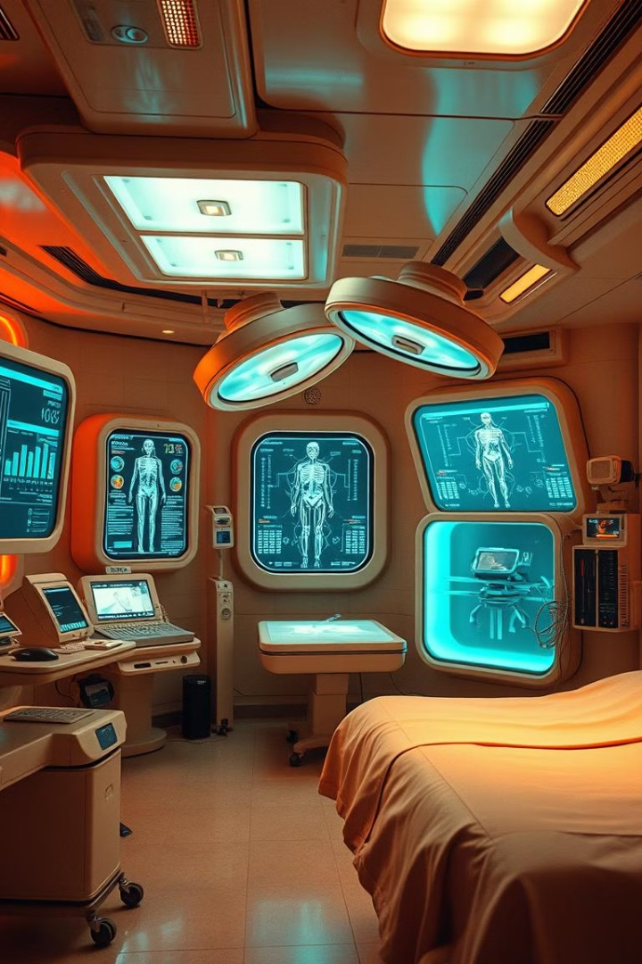
Future Directions in Telemedicine
1
Artificial Intelligence (AI) and Machine Learning
AI-powered tools can analyze patient data to identify potential health risks, personalize treatment plans, and enhance the efficiency of healthcare delivery.
2
Virtual Reality (VR)
VR technology can create immersive training simulations for medical professionals, improving their skills and knowledge. It can also be used for patient education and rehabilitation.
3
Wearable Devices
Advanced wearable devices can monitor vital signs, provide real-time data to healthcare providers, and facilitate remote patient management, empowering individuals to take control of their health.

Slide 12

Conclusion: The Future of Healthcare
Telemedicine has the potential to transform healthcare delivery, especially in underserved areas. By addressing the challenges and use of emerging technologies, we can unlock the full potential of telemedicine to improve patient outcomes and access to care.

